Slide 1

MINI-PROJECT REVIEW I
THE FILE CONVERSION APP
13-08-2025
WEDNESDAY
SURIYA M
24PCA531

Slide 2
Introduction
The File Conversion App is an offline Android application that allows users to convert files directly on their devices without the need for an internet connection. It ensures faster processing, enhanced privacy, and complete control over user data while supporting a wide range of file types, including documents, images, audio, and video. Users can simply select a file, choose the desired output format, and save it locally in just a few taps. Developed using Java for core logic and XML for the user interface, the app offers a smooth and responsive experience. It uses Room Database for secure local storage of user history, preferences, and settings, making it highly reliable even in areas with limited or no internet access. With its minimalistic design and intuitive navigation, the app provides a fast, convenient, and secure solution for everyday file conversion needs.

Slide 3
System Study
Existing System
current reliance on multiple online tools for file conversion
Many services require a constant internet connection
File size limitations and restricted formats on most platforms
Privacy concerns due to user data collection
Subscription fees for premium or unlimited features
Offline alternatives often have limited format support
Lack of a user-friendly interface in offline tools
Mobile apps often too basic (no search/customization) or too complex for casual users
Need for a solution with the right balance of functionality and simplicity

Slide 4
System Study
Proposed System
Unified Platform: Convert documents, images, audio, and video in multiple formats from one app.
Offline Use: Convert and save files without internet.
Fast & Secure: Efficient local processing with multi-format support and safe storage.
Easy to Use: Clean UI and smooth navigation.
Customizable: Choose output format, quality, and resolution.
Quick Search: Instantly find files with built-in search.
Data Recovery: Undo delete to prevent accidental loss.

Slide 5
System Study
○
Problem Definition & Project Description
People face challenges converting files quickly and securely in today’s fast-paced digital world. ○ Existing tools are: • Slow or require constant internet access • Restricted by file size limits • Complex to use • Lacking support for multiple formats in one place

Slide 6
System Analysis
SYSTEM REQUIREMENTS
HARDWARE REQUIREMENTS
Processor : Intel i3 or higher
RAM : 4 GB (8 GB recommended)
Hard Disk : 40 GB or more (for IDE, SDKs, and project files)
Monitor : 15’’ VGA/LED monitor
Keyboard : Standard 104 keys keyboard
Mouse : Optical mouse
Mobile Device (Testing): Android smartphone, minimum 2 GB RAM, Android 6.0 or higher, 50 MB free storage

Slide 7
System Analysis
SYSTEM REQUIREMENTS
SOFTWARE REQUIREMENTS
Operating System : Windows 10 / 11 (64-bit) or macOS / Linux
IDE: Android Studio (latest stable version)
Programming Languages : Java (Backend Logic), XML (UI Design)
Database : Room
Build System : Gradle
Android SDK : API Level 33 or higher (minSdkVersion 23)
Emulator / Physical Device: For app testing and debugging

Slide 8
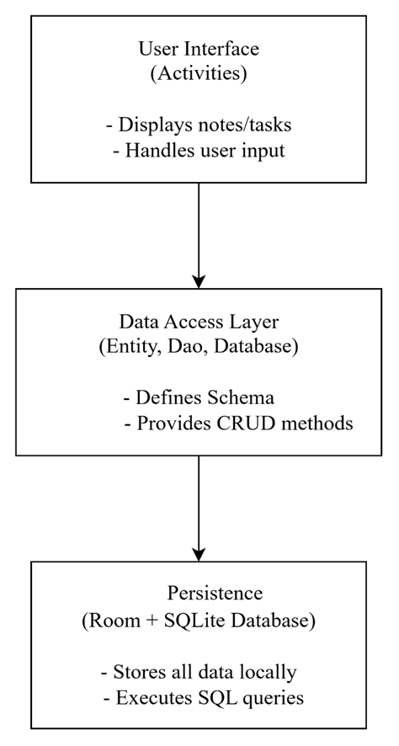
System Design
Architectural Design

Slide 9
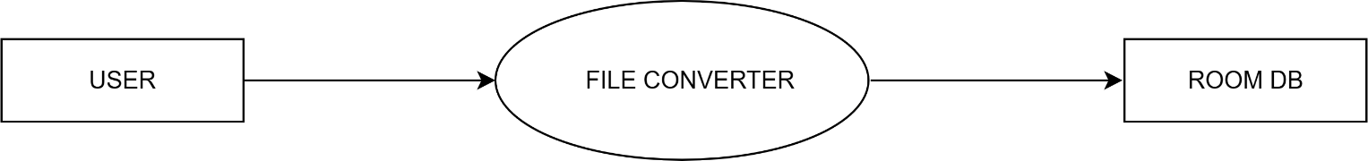
System Design
Data Flow Diagram
DFD Level 0

Slide 10
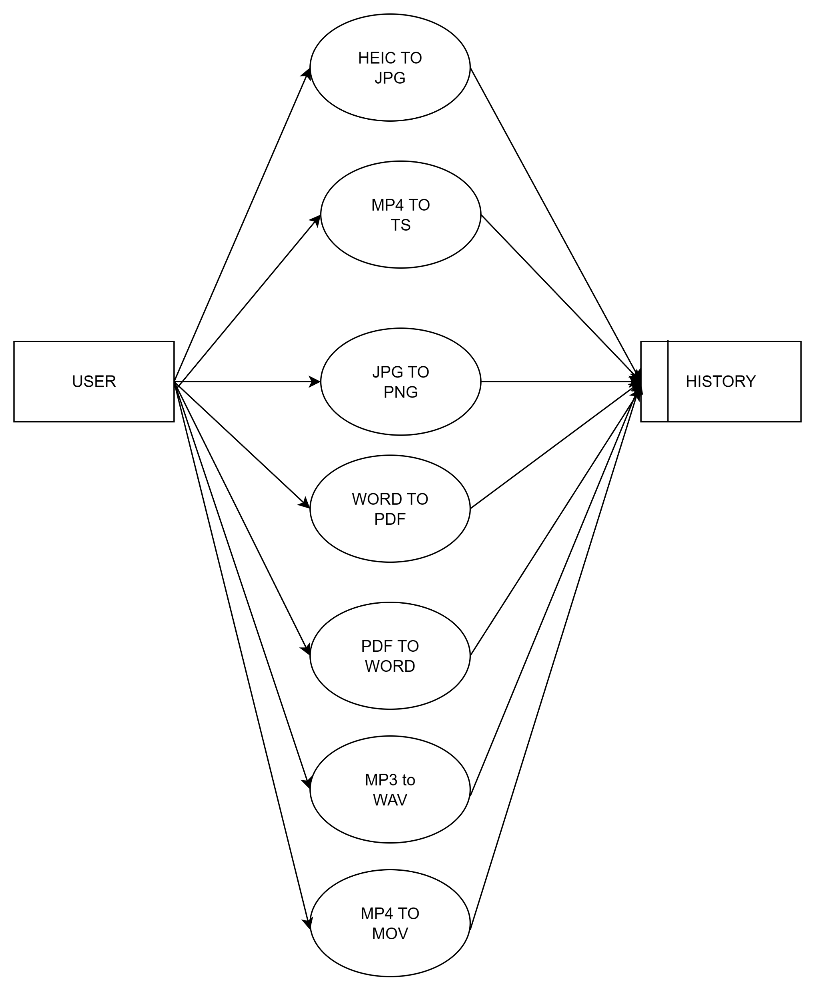
System Design
Data Flow Diagram
DFD Level 1

Slide 11
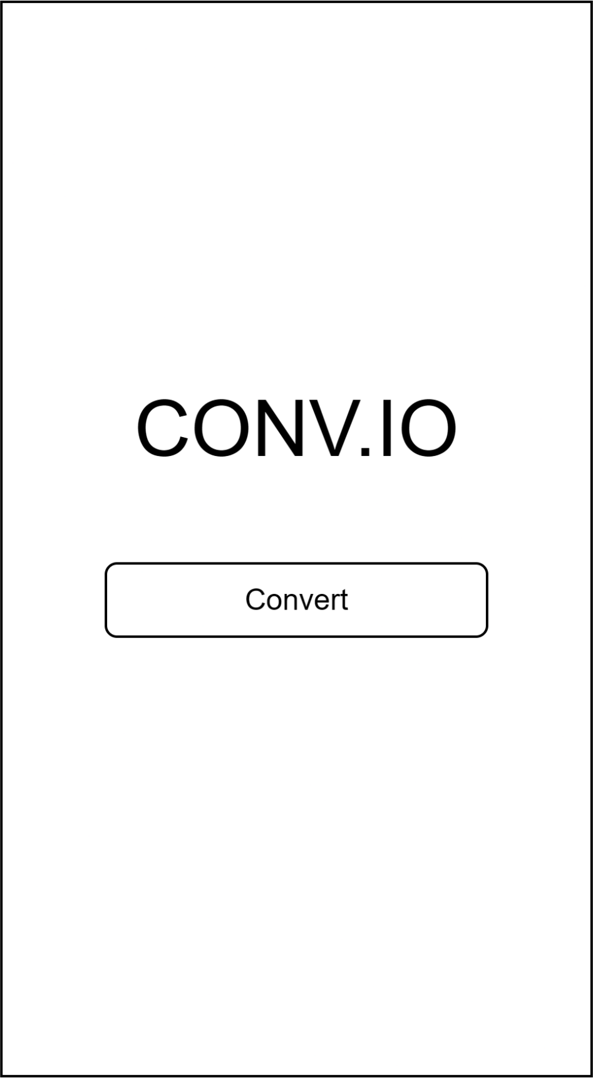
User Interface Design

Slide 12
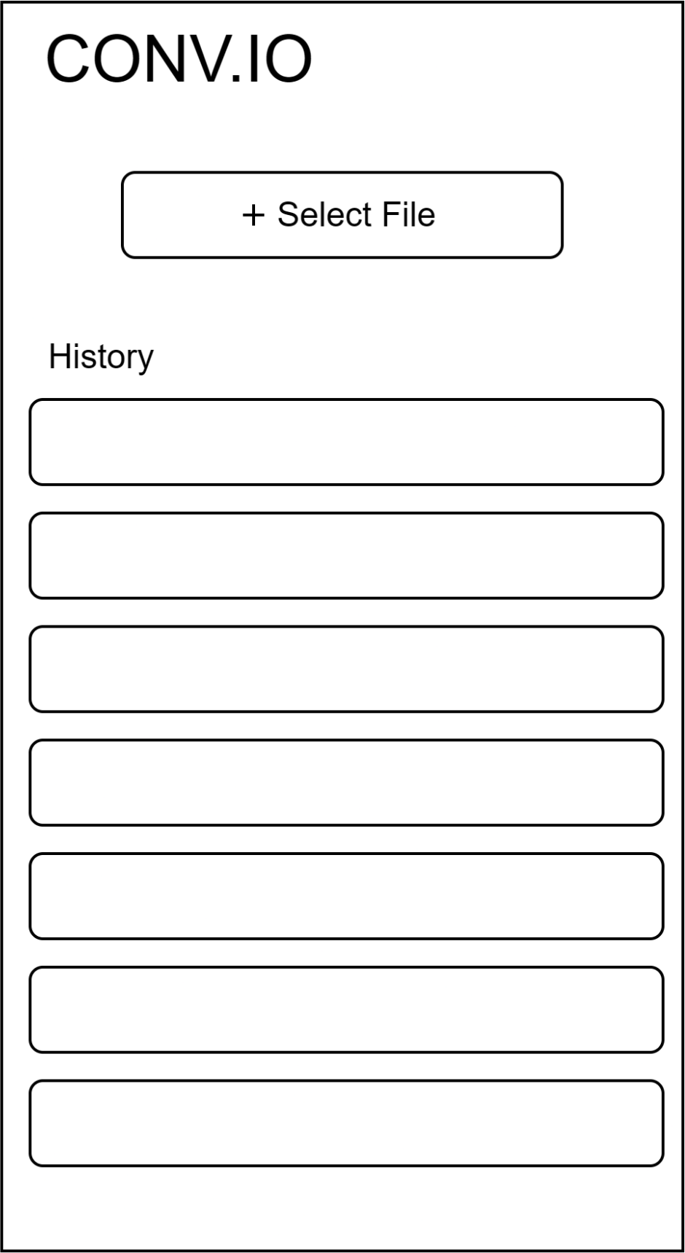
User Interface Design

Slide 13
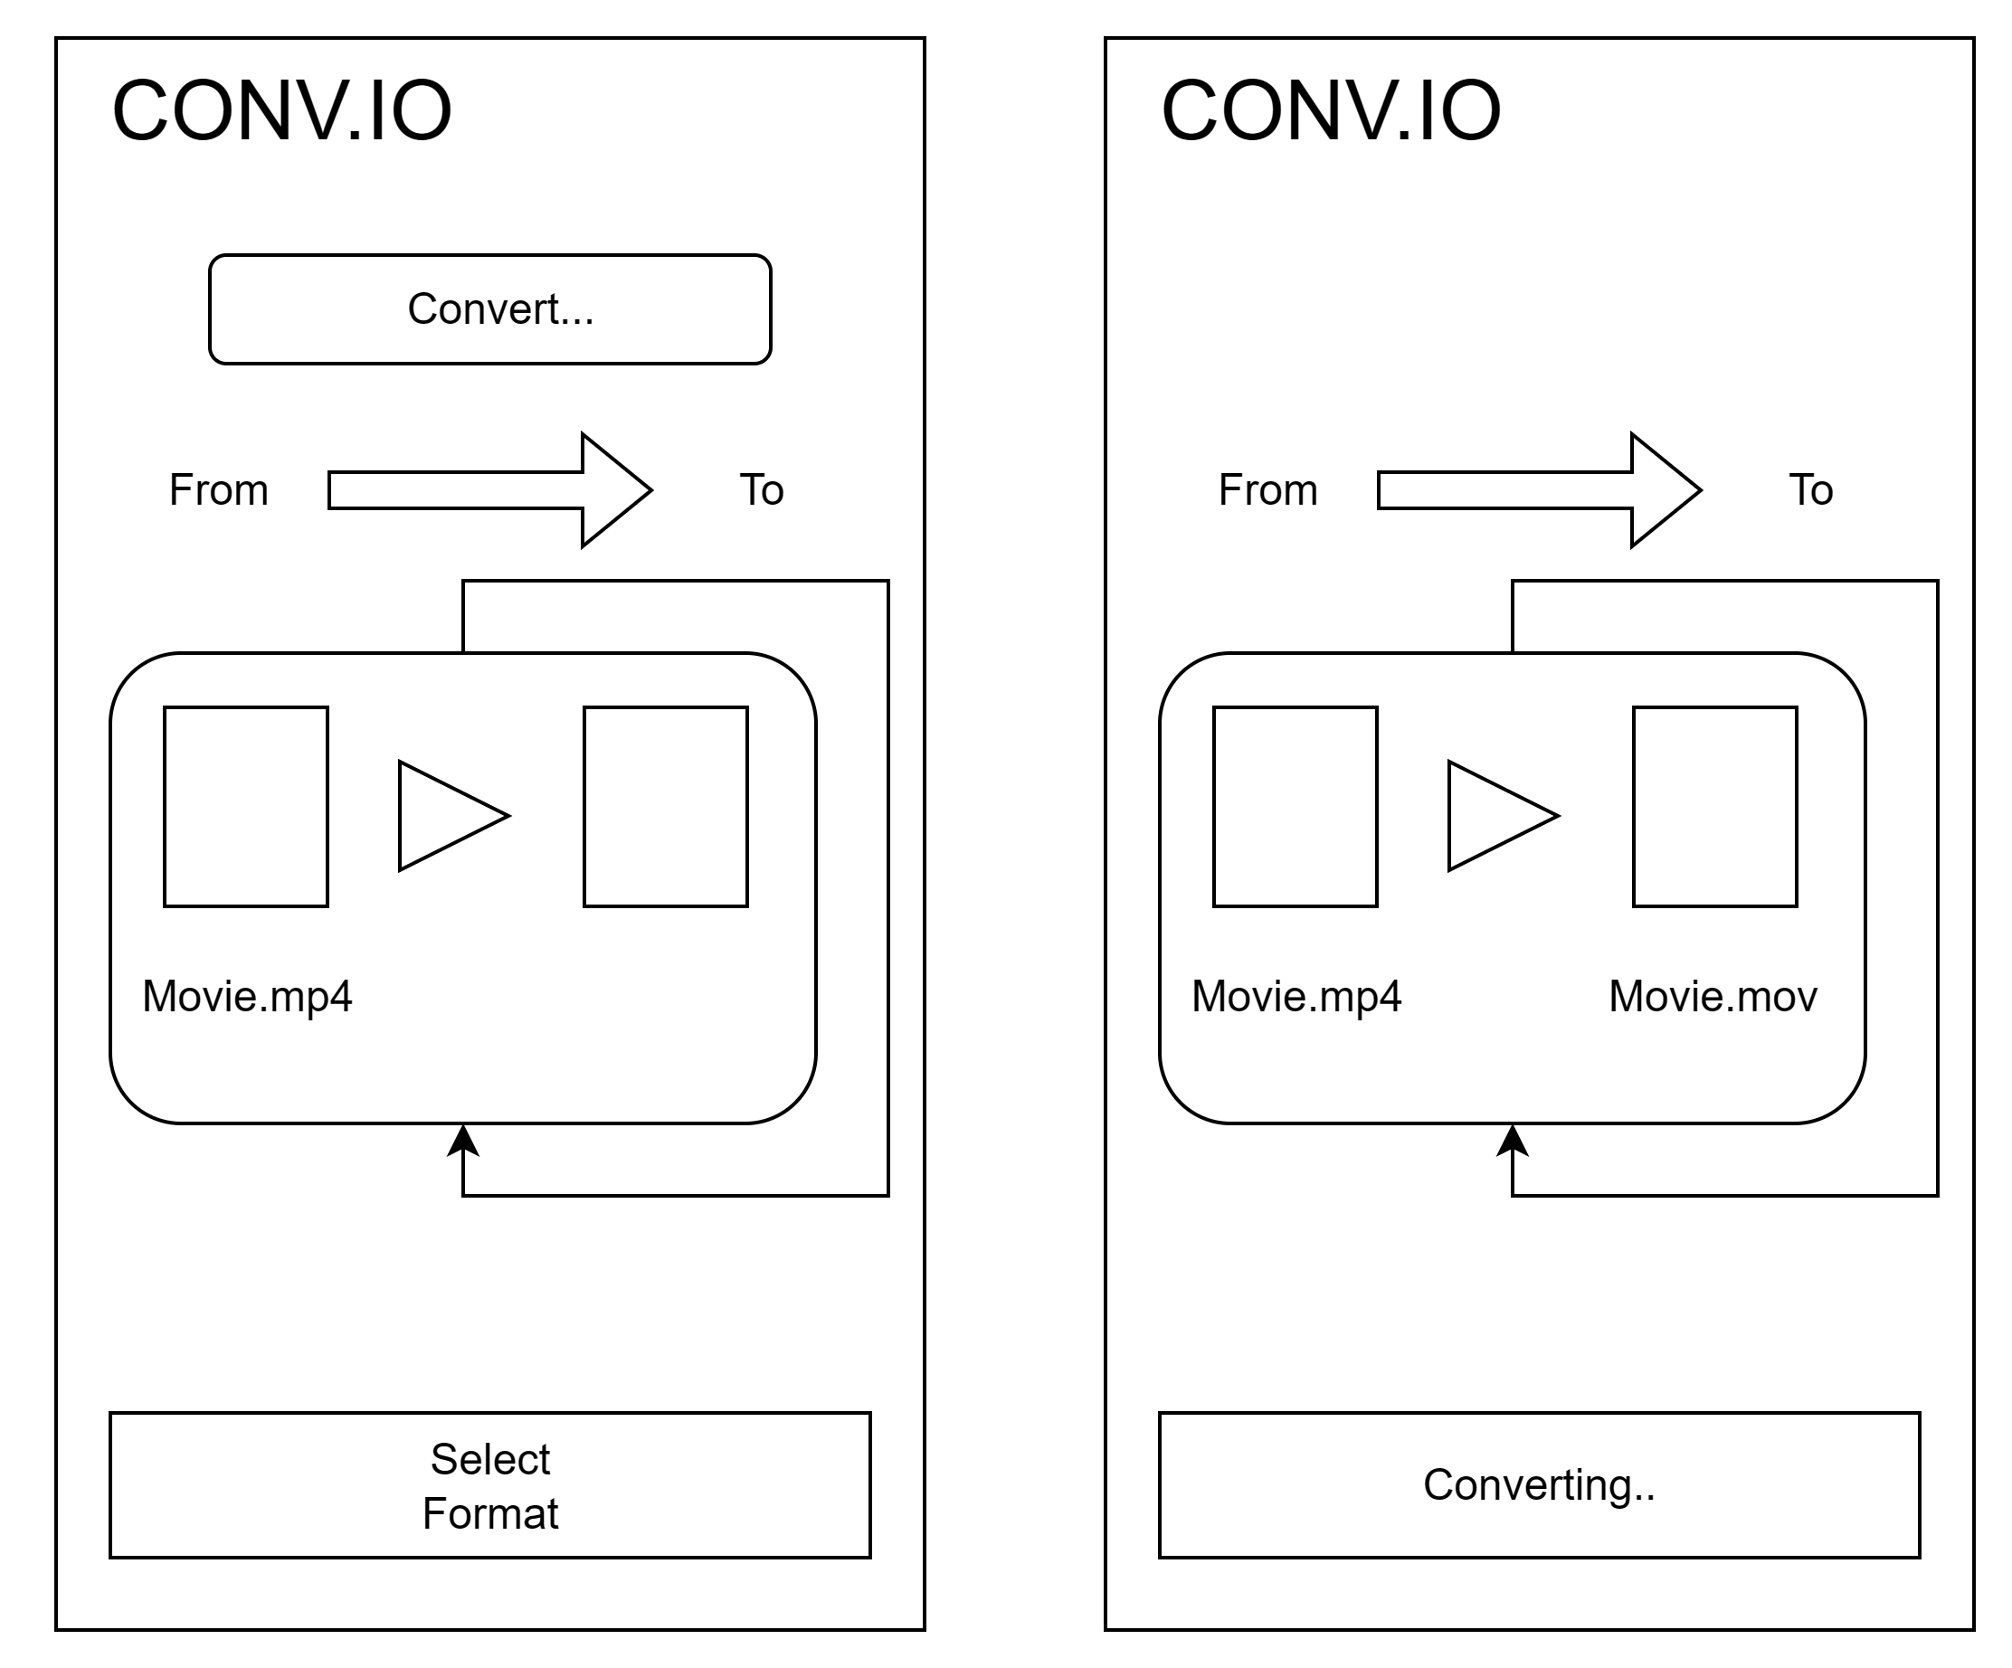
User Interface Design

Slide 14
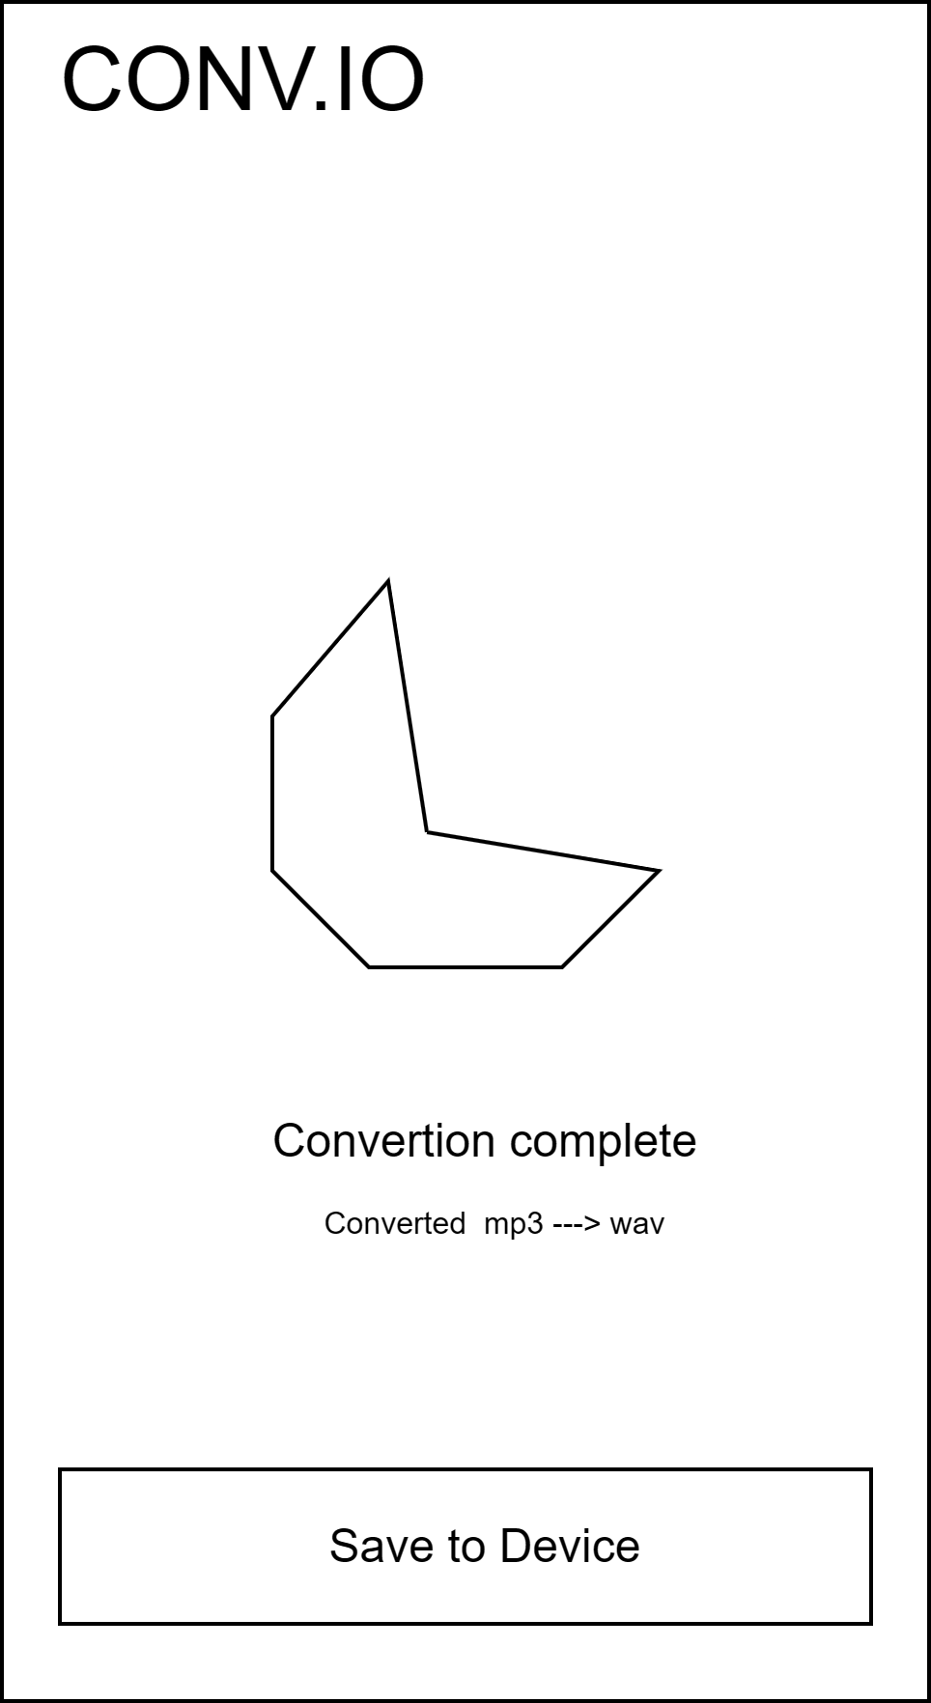
User Interface Design

Slide 15
Normalization
Normalization is the process of organizing the data in the database.
Normalization is used to minimize the redundancy from a relation or set of relations.

Slide 16
THANK YOU

